Slide 1
Analyzing and Visualizing Traffic Condition
Group :- APEX

Slide 2
Problem in brief
Unexpected traffic causes delay
Unnecessary stress on employees
Wastage of money and time
Health hazards

Slide 3
Our AIM is to…….
Developing a mobile application and a website to visualize the reliable traffic data in certain areas

Slide 4
Objectives
Detecting the locations
Detecting the speed of vehicles
A way to feed the data into the CEP
A way to analyze the GPS data
A way to retrieve the analyzed data from the CEP
A way to visualize the traffic condition in the android application and in the web site

Slide 5
Others work
Waze application
INRIX application
MY-TRAFFIC
Traffic, Radars & GPS-Glob

Slide 6
“Route Me “
Analyze real time traffic data using CEP
CEP can handle up to 6M events/sec on JVM
CEP facilitates temporal correlations between event streams with historic data
Visualizing is supported with mobile application and a web site

Slide 7
Our Approach
Users : Users of the mobile application
Inputs : GPS data
      -Technology used : Web service, Web socket,cloud service.
Process : Analyzing the traffic condition using CEP
Output : Visualizing the traffic condition
-Technology used :Web service,Web socket, cloud service

Slide 8
Design

Slide 9
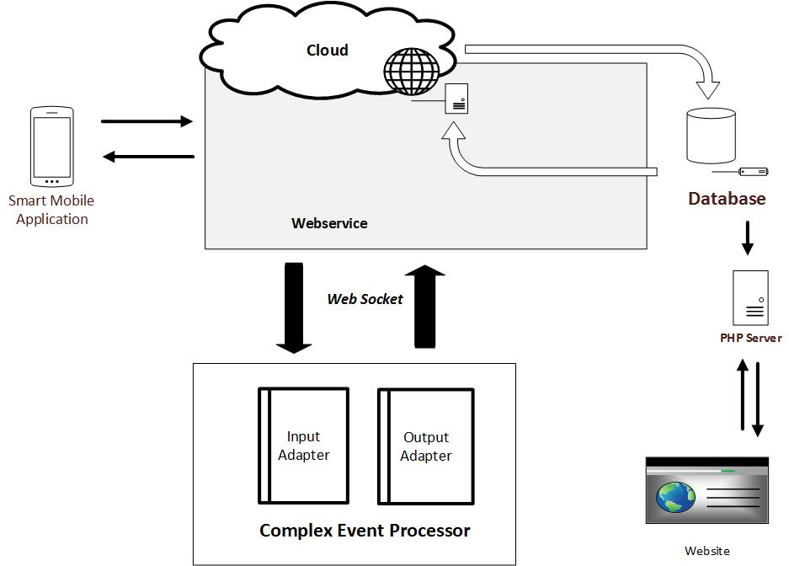

Slide 10
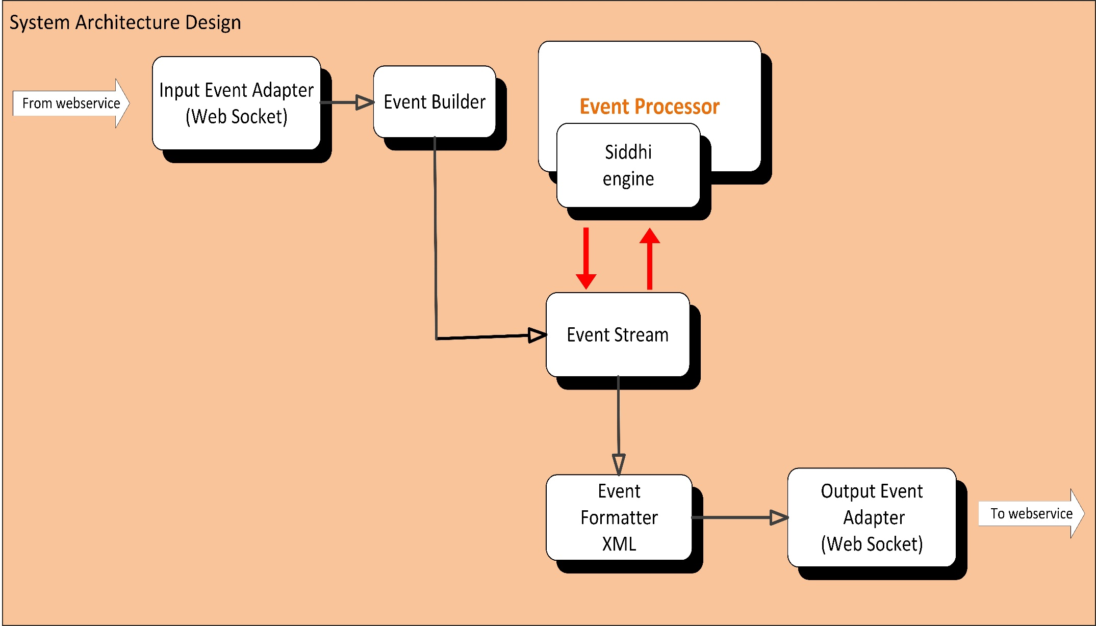

Slide 11
Implementation
Analysing traffic via CEP.
Used two methods.
First method.
Divide the road in to segments of 1 km
Use a timeBatch window.
Track each individual over a 1 minute and get the avg speed and max speed.

Slide 12
Implementation cont.....
max speed is used to distinguish mooving vehicle from a walking person along the street.
vehicles with avg speed zero is further analysed to check whether the particular vehicle in congested in traffic or parked near the road.
Finally analysed output is pushed through a web socket.

Slide 13
Implementation cont.....
Second method
Divide the road segments into polygons using geo-fencing feature.
One junction contains two polygons.
Entering time stamps for each polygon is recorded.
Time differnce of each vehicle is calculated.

Slide 14
Implementation cont.....
If it is negative that indicates the vehicle is travelling to the opposite direction.
The average vehicle speed of each direction is calculated.
Distance of road segment is divided by the average vehicle speed.
Average speed will determine the level of traffic.
REST API is used to retrieve anlysed data to outside apps.

Slide 15
Implementation cont.....
crowd sourcing and visualizing traffic data using smart phone
Detect location and speed of the vehicle using Google API
Use a timer class to call a web service at a frequency of 5 times per minute
Emi number used as the phone ID to distinguish users

Slide 16
Implementation cont.....
Since CEP does't have a public IP, we used a web socket to feed GPS data to CEP
Used a web socket to retrieve analysed data and store them in a database created using cloud technology.
Finally mapped each updated tuples to visualize them in the smart phone

Slide 17
Implementation cont.....
visualizing the traffic data on a website
developed to provide the current traffic condition to the users who are not willing to support crowd-sourcing
php was used to retrieve data from the main database
Accoring to the level of speed the location points will be marked using different markers

Slide 18
Evaluation
Used 15 users to get GPS data analysed the traffic condition.
Users were spreaded over katubedda,andulana,rathmalana & galkissa.
Results were compared with the real traffic contidion.
Smart phone dispalyed the traffic level as it was.

Slide 19
Further work
Extend the traffic analysing area specially in sub roads in Colombo.

